Slide 1
Project 2 : Cellular response to drug perturbations

Slide 2
NCI Transcriptional Pharmacodynamics Workbench
NCI-60-Cell line
12,704 genes
3 time points (6, 12, 24 h)
2 concentrations ( c_{max} , GI₅₀)
15 drugs
Comparison untreated and treated transcriptional expression

Slide 3
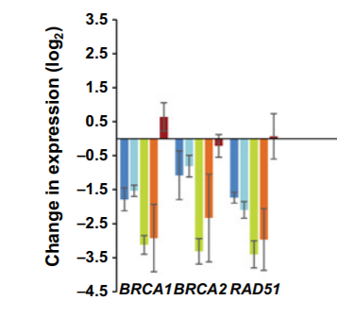
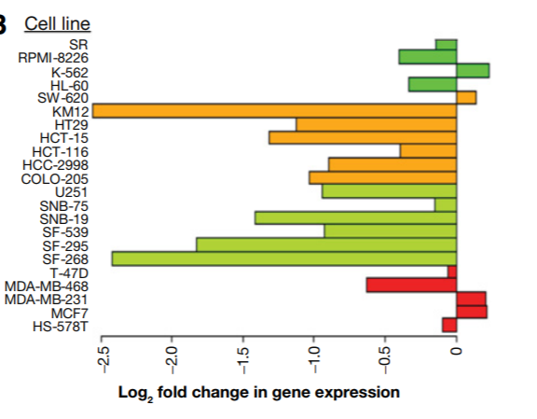
1. Milestone – Find the mostly regulated genes and cell lines by erlotinib
Goal:
Which 15 cell lines are most effected under the
EGFR- kinase inhibitor Erlotinib ?
Which 15 genes are influenced the most?
Method:
Normalization of transcriptional expression data
Compare variance of changed gene expression in different cell lines -> choose 15
Principal component analysis: which genes are most
responsible for PC1 and PC2
Plot single-gene response of the three most regulated genes
for 15 cell lines and colour the cancer type
Notes:
Differences between cell lines are more relevant to expression than drug treatment in PCA -> Treated (logarithmic data) - untreated (logarithmic data)

Slide 4
2. Milestone – correlation of gen expression changes vs. drug sensitivity
Goal:
Compare the most effected cell lines with the drug sensititity data
Method:
Calculate the median of gene expression changes of the most influenced cell lines
Pearson Correlation with drug sensitivity
T-test (Benjamin- Hochberg- Korrektur)

Slide 5
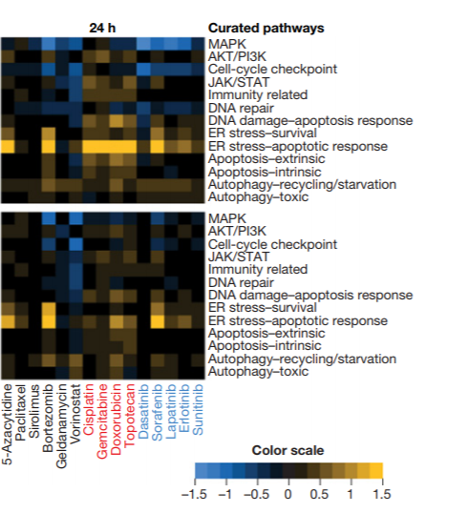
3. Milestone – which cellular pathway’s are influenced by erlotinib
Goal:
Which genes are overexpressed, which expression decrease under erlotinib treatment
Cellular meanings of the changed gens
Method:
Use PROGENy to determine, which cellular pathways
are affected
Create a heatmap: cell-lines vs. pathways
(median of gene expression of relevant genes)
Hypothesis und t- tests
How does the treatment affect cell growth?
Are there similarities between erlotinib and other
15 Cell lines

Slide 6
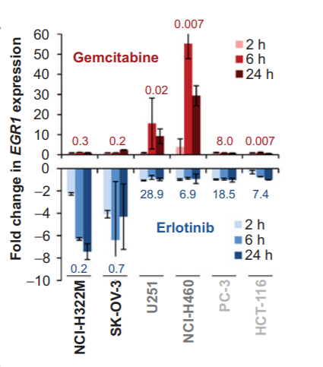
4. Milestone – compare gene expression with different time points
Goal:
How does the gene expression change with increasing periods of treatment?
Is there any other drug, which shows the same pattern?
Method:
Search in the NCI workbench for the data with
the time points of 2h and 6h
Compare the median gene expression of different cell lines
over different time intervals
Compare this with other drugs, which might follow the pattern

Slide 7
Timeline
12 Weeks
with 2 weeks for each mile stone
4 weeks at the end to interpret the data and come up with future investigations, which could provide novel insight

